Slide 1



Weaning stress in piglets plays an important role in the emergence of novel viral genomic variation from zoonotic transmission of Influenza A Virus
Dr. Carl R Hutter
(carl.hutter@usda.gov)
ORISE/SCINet Postdoctoral Fellow
USDA-ARS
National Animal Disease Center
Virus and Prion Unit
Ames, IA
Advisor: Dr. Tavis Anderson

Slide 2
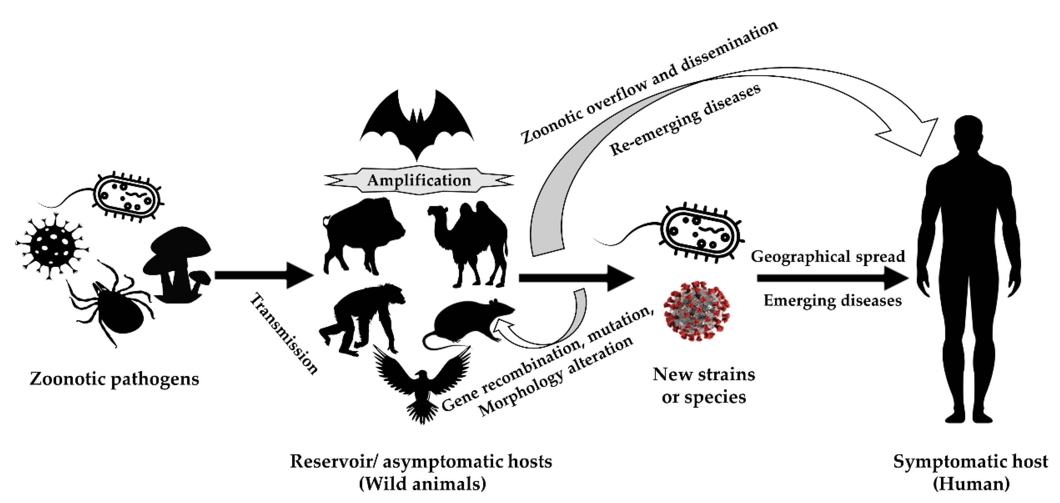
Zoonotic transmission
Zoonotic transmission
Animals to humans
Reverse zoonotic: humans to animals
Genetic variation
Host jumping = new host environment
Differential selection = novel adaptations
Pandemic potential
Influenza A (1918 Flu, 2009 Flu H1N1)
SARS-CoV-2
Wikipedia
Notes:
Understanding Zoonotic transmission and how it relates to viral genetic variation and evolution is critical to preventing future pandemics.
Genetic variation is important because when the host jumps to a new environment ….

Slide 3
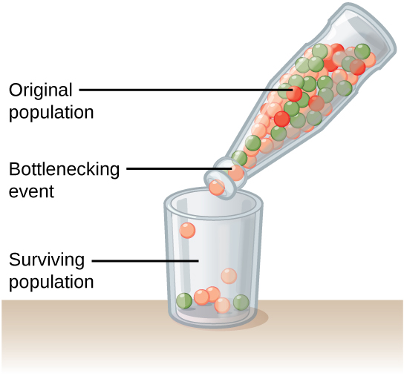
Why is genetic variation important?
Adaptation to host
Founding population
Bottleneck effects
Rapid evolutionary responses
High mutation rate / short generation time
New host environment = new viral variants
New phenotypes, higher fitness
Low frequency variation
Natural selection / drift can lead to high frequency
More fit phenotypes (e.g., transmissibility, virulence)
Kahn Academy
Notes:
Why is genetic variation important?
To understand and prevent pandemics, it is critical to understand genetic variation during zoonotic transmission events.
Upon the transmission and colonization of a new host, initial adaptation is influenced by the genetic variation of the founding population.
A new host environment can lead to rapid evolutionary responses …
Importantly this can infect other individuals or host switch again.

Slide 4
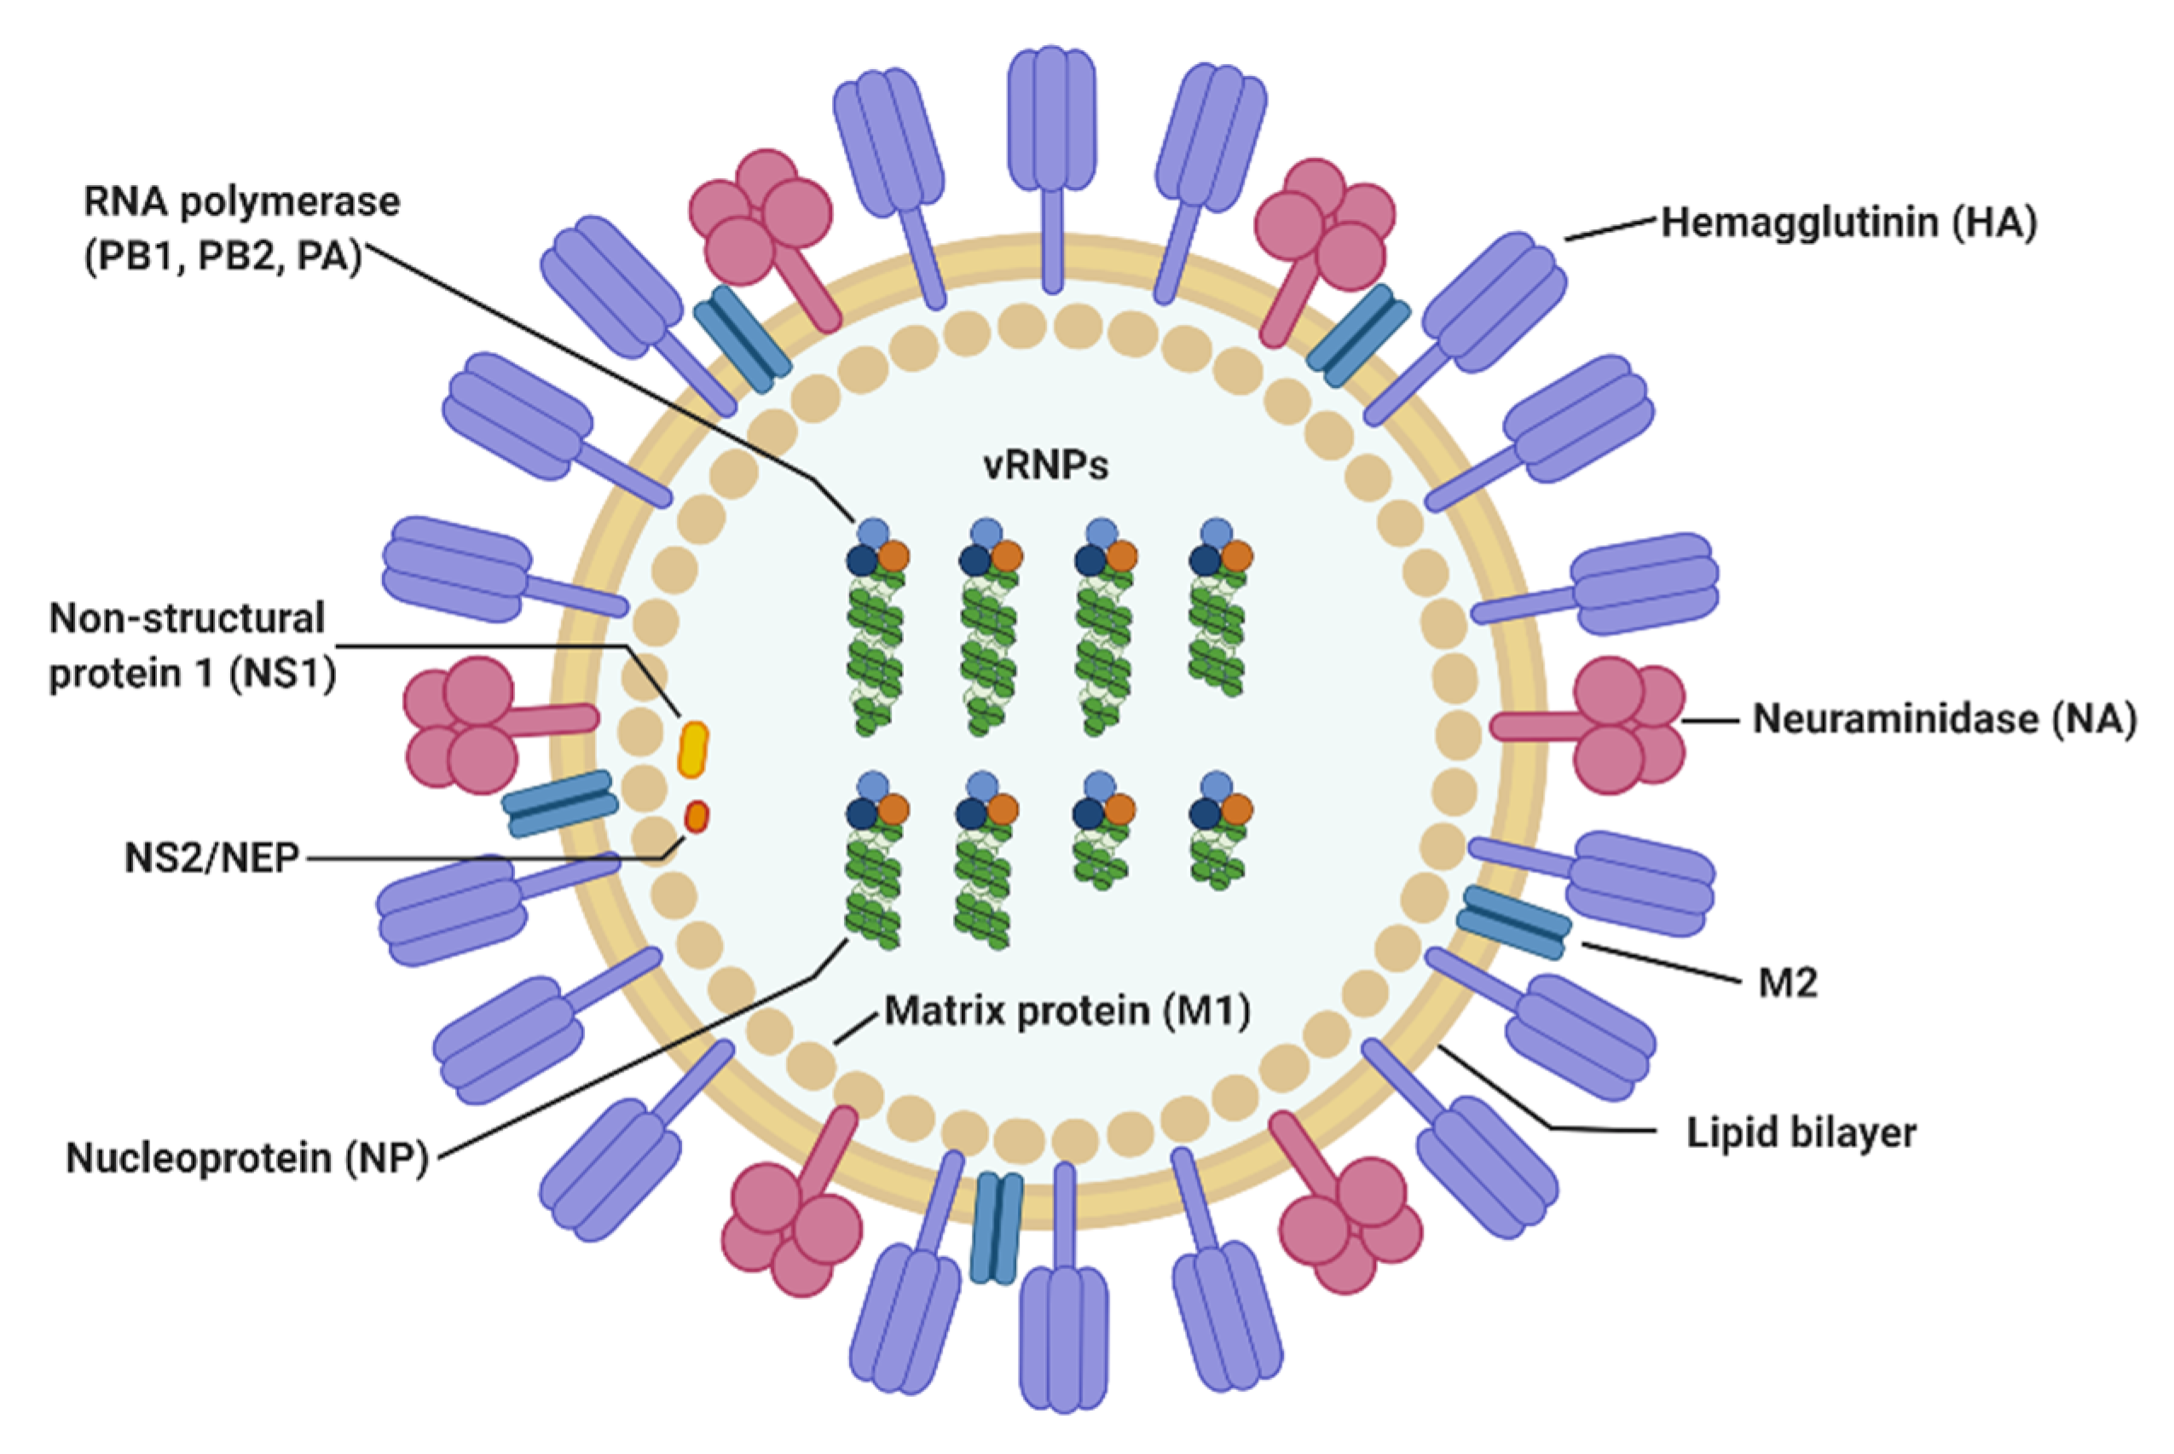
Influenza A (IAV)
Many Zoonotic events
swine to human / human to swine? (1918 pandemic)
Swine to human (2009 H1N1)
Human to swine (2010 H3N2)
Avian flu (bird to human / mammals / poultry / cattle)
Swine important
Constant human contact
Mixing vessels, reservoirs
Pandemic potential
Wikipedia
Notes:
An ideal viral system to address how host switching shapes genetic variation and adaptation in a new host is Influenza A or IAV.
There have been many documented Zoonotic events involving IAV from swine to humans and humans to swine and some birds also.
IAV is great for assessing genetic diversity as it rapidly mutates. Swine are particularly important as they are mixing vessels and reservoirs for new strains and are in constant contact with humans and could reinfect human populations.
Because of the pandemic potential it is important to understand how IAV evolves upon host-switching events.

Slide 5
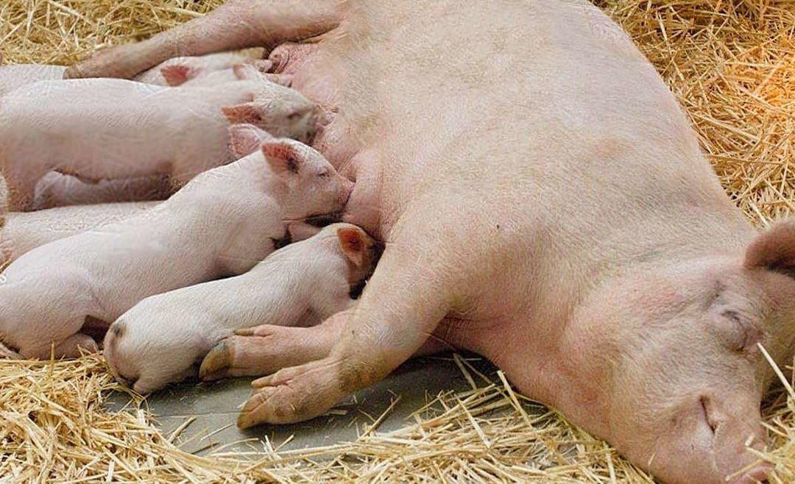
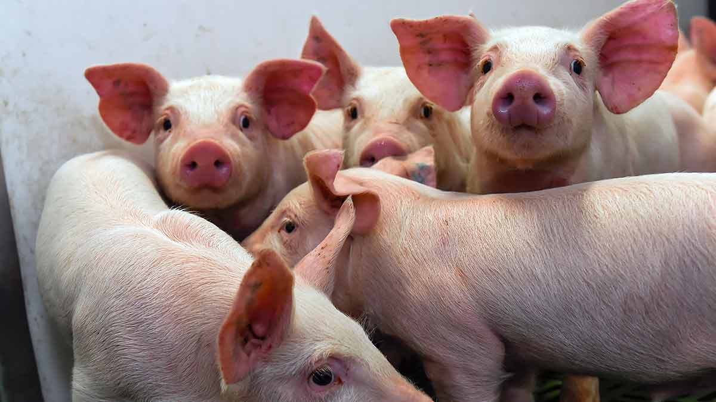
Study Design (Zanella et al., in prep)
Created virus to mimic human to swine
IAV 2010.1 H3N2 introduction
Inoculated piglets
Maternal antibody groups:
Vaccinated match (vax match)
Vaccinated mismatch (vax mismatch)
No Vaccine (no vax)
Subgroups:
With Sow (happy piglets)
Weaned (stressed piglets)
Evaluated viral shedding / transmission
Notes:
This study is a companion to another study in our group, where they created a virus to mimic the human to swine IAV introduction in 2010 and Inoculated piglets with the human-like IAV.

Slide 6
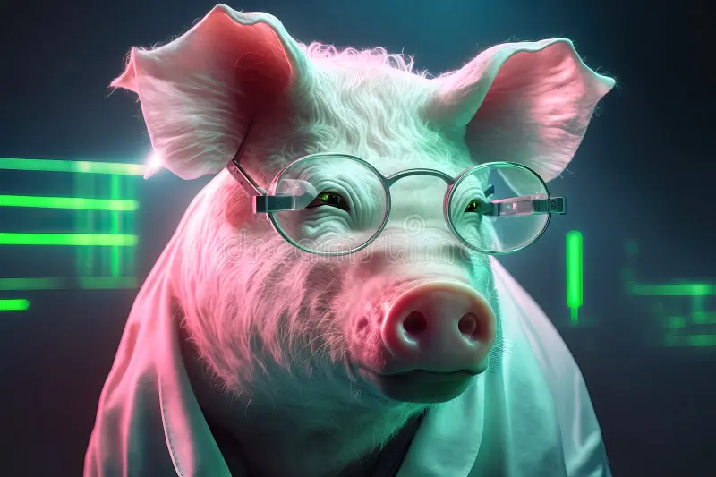
Study Design
Main question:
Does weaning stress increase viral genetic diversity?
Prediction: Weaned piglets have higher nucleotide diversity
Notes:
So this nicely sets up our question here, does the increase in shedding and transmission lead to increased viral genetic diversity?

Slide 7
Study Design – Sequencing
Why weaning stress?
Stressed piglets = weakened immune system
Weakened immune system = increased viral genetic diversity?
First study to address this question
Agricultural impact
Nasal swabs for DNA sequencing
Days 1, 2, 3, 5, and 7 sequenced for Whole Genomes (WGS)
Notes:
This study is the first to address this core question.
We reason that because stressed piglets have a weakened immune system, this would allow the virus to replicate more readily and thus increase diversity.
To obtain genetic data, nasal swabs for DNA sequencing were collected every day for up to 7 days.
Days 1,2,3,5 and 7 were sequenced for whole genomes for around 200 samples.

Slide 8
Study Design – Sequencing
Sample sizes
78 total piglets in study
72 sequenced with qPCR Ct < 35
57 with variants and virus from sequencing
142 whole genomes across multiple days (not all days were successful)
Treatment | Number Days | Number Piglets
Vax match with sow | 2 | 2
Vax match weaned | 2 | 2
Vax mismatch with sow | 4 | 6
Vax mismatch weaned | 5 | 12
Non vax with sow | 5 | 18
Non vax weaned | 5 | 17

Slide 9

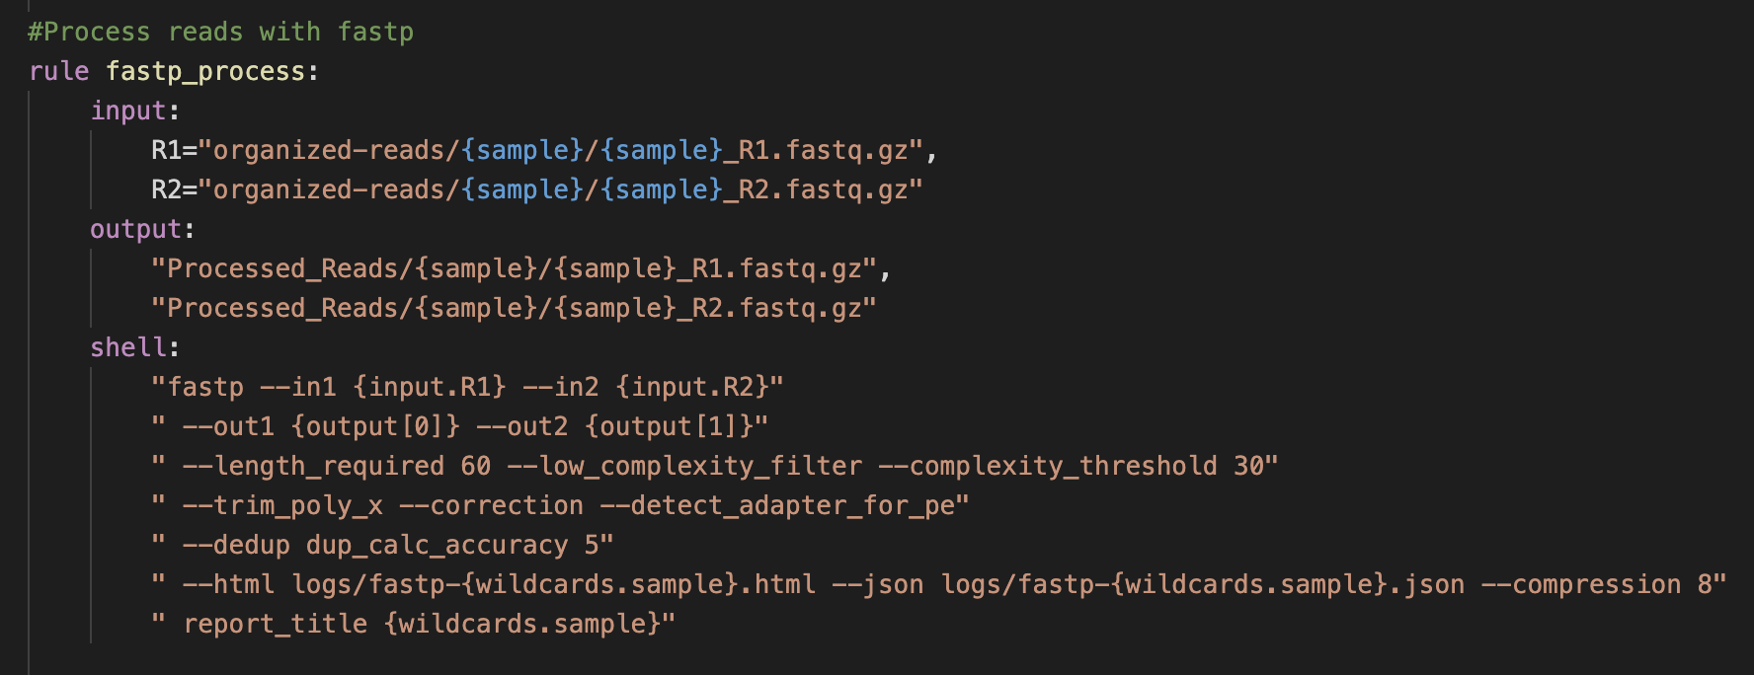
Methods: “Flumina” Pipeline
Uses SnakeMake (pipeline manager)
Programs: fastp, BWA, samtools, GATK4, LowFreq, SNPGenie, IRMA
Custom scripts
https://github.com/flu-crew/Flumina
Notes:
To analyze the sequence data, I developed a new pipeline I called “Flumina”. It is written in Python and uses SnakeMake for the program execution and custom python scripts for other tasks.

Slide 10
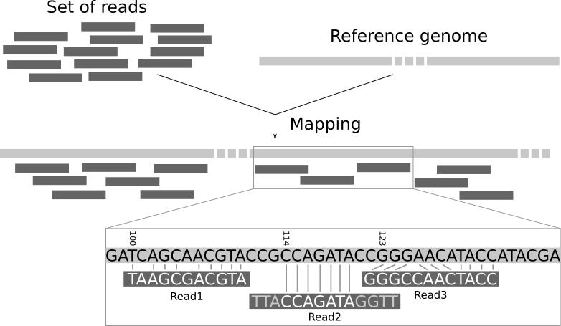
Methods: Flumina Pipeline
File Organization
Make reference
Preprocess reads
Map reads
Call variants (high and low frequency)
Estimate nucleotide diversity
File
Organize
Make Reference
Preprocess
Reads
Map
Reads
Single
Nucleotide
Variants (SNVs)
VCF
Data
Analysis
Notes:
The first step is to organize the input files. This is done with a custom python script that moves files around and gives them new names.

Slide 11
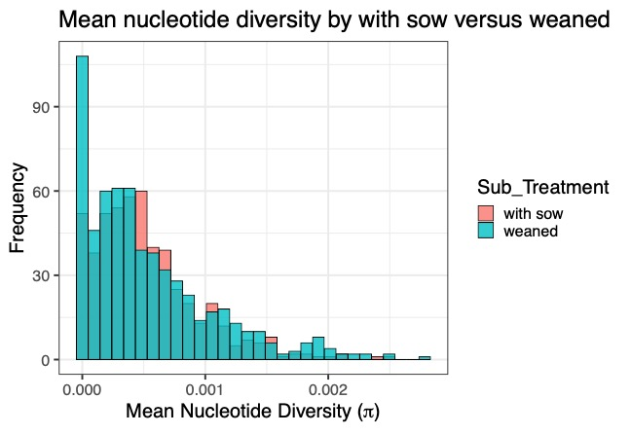
Results: Nucleotide Diversity
Nonsignificant difference
T-test (p = 0.452)
Similar distributions
Notes:
For the first test, when comparing all the samples across all the treatments, there is no significant difference between nucleotide diversity in with sow and weaned piglets using a t-test to test for a difference in means between the two groups.
The distributions are similar, as shown on the figure on the left with diversity on the X axis and sample frequency on the Y.

Slide 12
Results: Nucleotide Diversity
Pairwise t-test of weaned vs sow in each treatment
Vax match group: with sow significant (t-test, p < 0.001)
No evidence for weaned groups having more genetic variation
Notes:
Second, when separating the weaned and with sow piglets into the vaccine groups, a bar plot is shown on the left with Vaccine Treatment on the X axis and Diversity on the Y with the red showing the with sow group and blue the weaned group,
there is only a significant difference between the vaccine match group, however, the with sow had higher nucleotide diversity, which goes against our prediction that weaned would have more.
This probably happened because the Vax Match groups had the fewest samples because it was difficult to sequence them as they had reduced viral shedding and less virus to sequence.

Slide 13
Results: Nucleotide Diversity
Mean diversity each day of samples within each treatment
Non vax had highest diversity across days when compared to the other groups
Non vax weaned highest
Vax match lowest, low viral loads
Notes:
Finally, maybe there is a difference if we look at individual days?
For each day samples were taken in the study, we took the mean diversity for each sample within each treatment.
The results are plotted here, with Day on the X axis and Diversity on the Y.
The different treatment groups are colored via the legend on the right, with the important lines being the non vax group in red.
The non vax groups in red had the most diversity across days, but also have what appears to be a difference between the weaned and with sow group with the weaned in the lighter red color having more diversity!

Slide 14
Results: Nucleotide Diversity
Box plots of the previous chart
Non vax weaned significantly higher on Day 5 (p < 0.001)
Non vax weaned significantly higher on Day 7 (p = 0.012)
Notes:
We made box plots of the previous plot to assess the variation. The Day is shown on the X axis and diversity Y, with each treatment having a box plot for each day.

Slide 15
Results: Nucleotide Diversity
Box plots of the previous chart
Non vax weaned significantly higher on Day 5 (p < 0.001)
Non vax weaned significantly higher on Day 7 (p = 0.012)
Notes:
On day 5 and 7 in the green boxes, the light red Non-Vax Weaned has much more diversity than Non-Vax With Sow in dark red.
When testing using a pairwise t-test, the Non-Vax Weaned group had significantly more variants on both Days 5 and 7.

Slide 16

Main Question
Does weaning stress increase viral genetic diversity?
Prediction: Weaned piglets have higher nucleotide diversity
Notes:
So yes, these results on the Day 5 and Day 7 support our predictions!
For our second question, do piglets with a matching vaccine stifle within-host viral evolution? We predict that the maternal vaccinated group has the least amount of nucleotide diversity.

Slide 17
Discussion
Weaning stress did not lead to higher genetic diversity in days 1-3
day 5 and day 7 in non vax group had high diversity
First time stress shown to increase viral diversity
Delayed effect of stress?
Notes:
For the first time, we found that weaning stress led to significantly higher genetic diversity, but only later in the infection on days 5 and 7.
The companion study found that the weaning stress in the piglets led to increased viral shedding and transmission of the virus.
Interestingly, there was no difference on the first 3 days swabs were taken, so there may be a delayed effect the stress has on genetic diversity.
One aspect to look at later would be to see if the viral shedding differed each day and if its correlated with genetic diversity.

Slide 18
Discussion
Agricultural impact
Animals under stress more likely to create costly new variants
Pandemic potential increases
Maternal antibodies from vaccines protect pigs and people

Slide 19
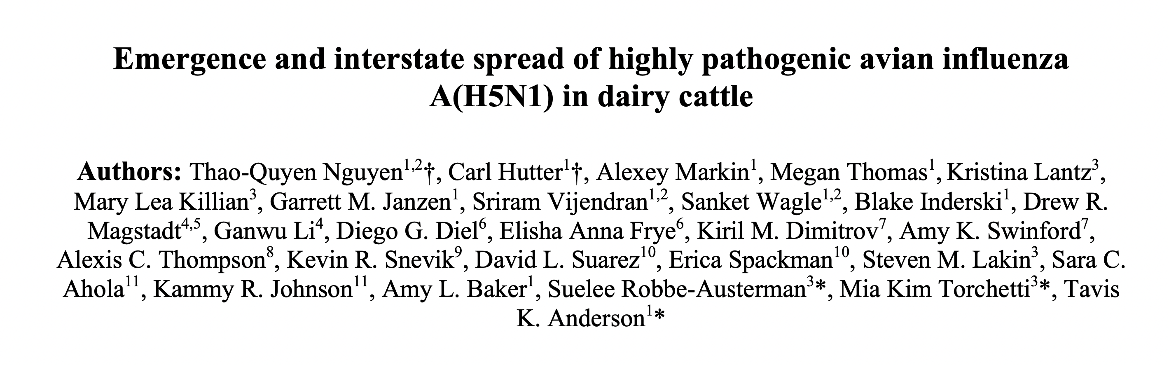
Present directions: HPAI in Dairy Cattle
Emergence
Wild birds in north America since late 2021
First detected in cattle in March 2024
One human dairy farm worker
A need to rapidly characterize virus
Nguyen et al. 2024, BioRxiv
APHIS + ARS collaboration
Methods
Flumina
Scanned ~500 samples / ~222 cattle for low frequency variants
Compared to database of functional mutations
Notes:
For present and future work, the Flumina pipeline I created allowed us to quickly respond to the emergence of Highly pathogenetic avian influenza in dairy cattle

Slide 20
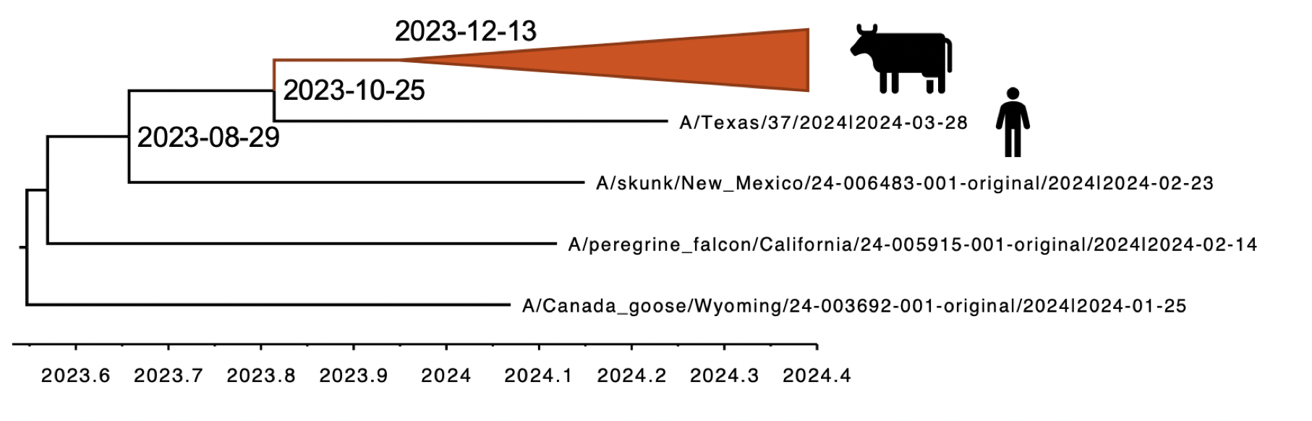
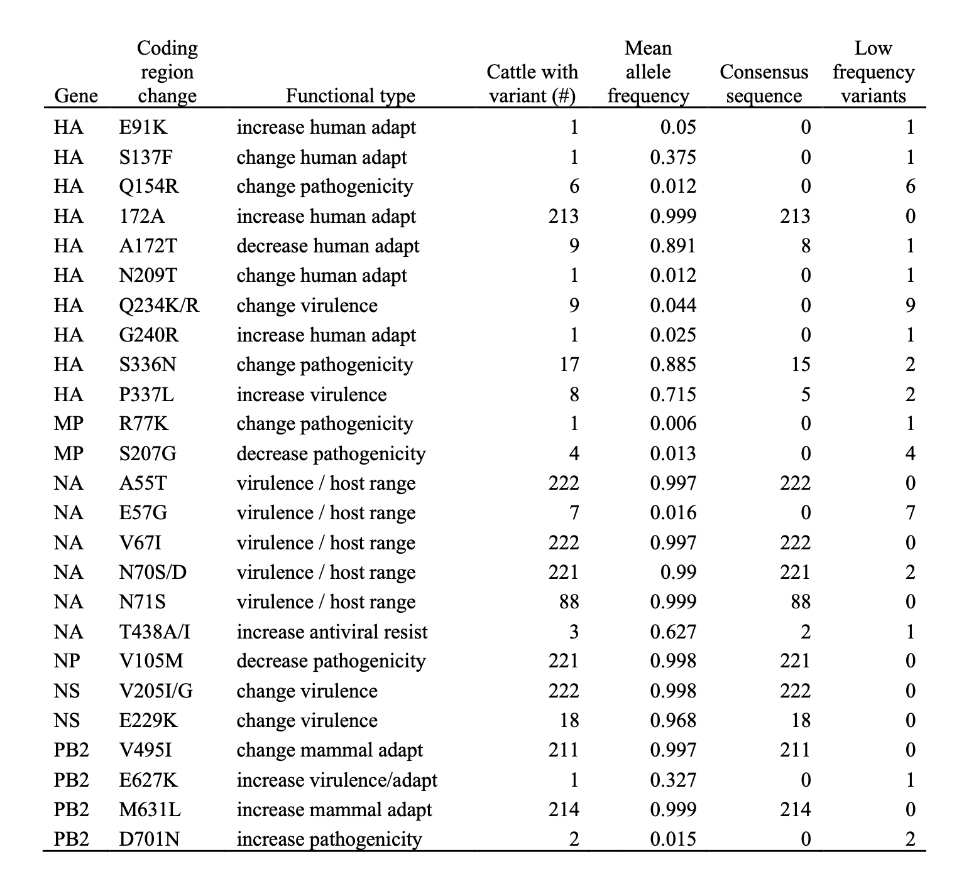
Present directions: HPAI in Dairy Cattle
Reassortment in wild birds
Transmission from cattle to other animals
Movement of asymptotic cattle
Concerning mutations
Site-binding receptors in humans
Increased virulence, pathogenicity, transmission
Some mutations low frequency
Not detected with traditional means
Can quickly become high frequency
Natural selection, linkage

Slide 21
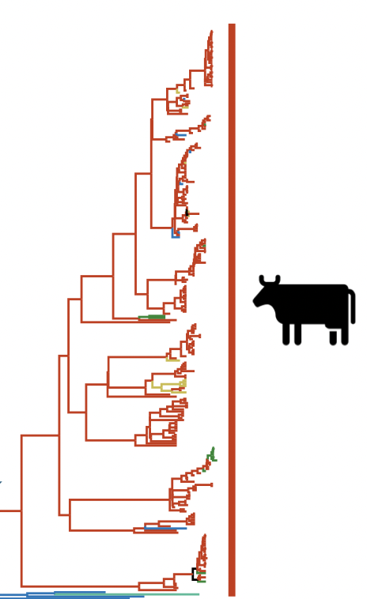
Present directions: HPAI in Dairy Cattle
Flumina was ready to go!
Quickly responded to threat
Batch generated SNV datasets overnight
Matched to known H5 mutation lists
Pipeline used as a part of APHIS NVSL ongoing surveillance
Can detect low frequency variants
Respond to concerning mutations

Slide 22
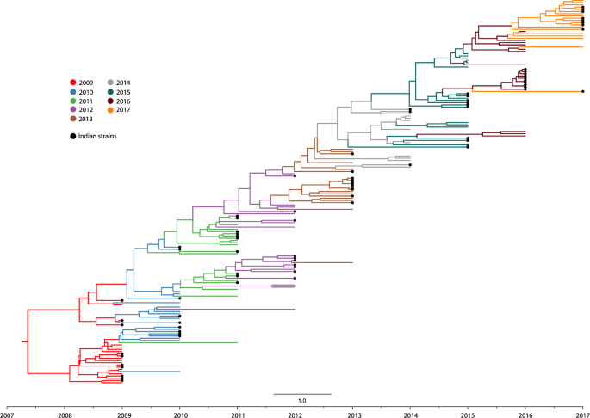
Future directions
Machine learning surveillance
Largest zoonotic transmission dataset
Dataset can be used for model training
Identify and predict zoonotic transmission on phylogeny with sequence data
Aid in surveillance efforts of influenza
Jones et al. 2017

Slide 23
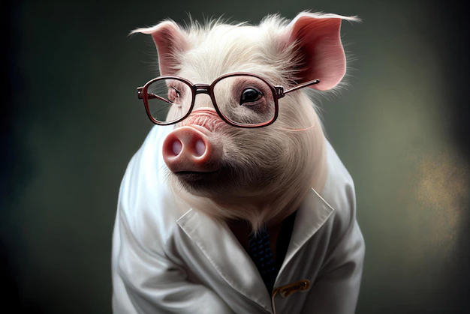
Thank you!
Acknowledgements:
Tavis Anderson
Giovana Zanella
Matias Cardenas
Daniela Rajao
Amy Baker
Bailey Arruda
Celeste Snyder
Daniel Perez
Microsoft AI image generator
Questions?

